Slide 1
Health Insurance Project Update
Kanchan Bhattarai

Slide 2
Agenda
Project Overview
Requirements
Design & Implementations
Analytics & Result
Conclusion

Slide 3
Project Overview
Project Goal
Design and Implement Data Pipelines leveraging big data tools which helps the stakeholders make effective data-driven decisions
Analyze customer behavior to customize insurance policies and boost engagement.
Use insights from competitor data to uncover market trends and potential opportunities.
Increase revenue by determining royalties for past customers and driving decisions with data.

Slide 4
Requirements
Use Cases : Sprint 1 (Current Sprint)
Requirement Documentation and Design Document
Which disease has a maximum number of claims.
Find those Subscribers having age less than 30 and they subscribe any subgroup
Find out hospital which serve most number of patients
Use Cases : Sprint 2 (Next Sprint)
Find out which subgroups subscribe most number of times
Find out total number of claims which were rejected
From where most claims are coming (city)

Slide 5
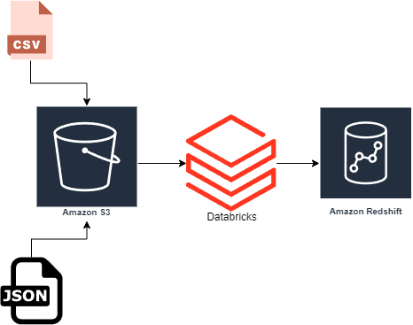
Design & Implementations
Data Ingestion: Data is ingested from multiple sources, including CSV and JSON files containing patient records, claims, and subscriber information from 3rd party and we scrapping.
Amazon S3 Storage: The raw data is stored securely and centrally in Amazon S3, providing a scalable repository for further processing.
Databricks Processing: Databricks is used to clean and transform the data using PySpark, ensuring it is prepared for analysis.
Amazon Redshift Loading: The cleaned and transformed data is loaded into Amazon Redshift, where it can be queried to generate business insights.

Slide 6
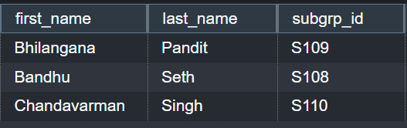
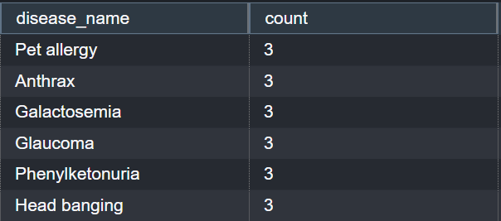

Analytics and Result
Find those Subscribers having age less than 30 and they subscribe any subgroup
Find out hospital which serve most number of patients
Which disease has a maximum number of claims.

Slide 7
Thank you
Any Questions/Comments?

